Slide 1
Asynchronous and parallel programming
Ing. Tomáš Andrek

Slide 2

Basics
Core: is an individual processor within a CPU.
Thread: is a single sequential flow of control within a program.
Asynchronous programming: non-blocking, without waiting
Parallel programming: run multiple things at the same time
Synchronization: is the concurrent execution of two or more threads that share critical resources.

Slide 3


Async and parallel in .NET
.NET 4.0
Parallel Extensions Library
Task parallel library (TPL)
Parallel LINQ (PLINQ)
Thread
.NET 1.0

Slide 4

Async / await (C# 5.0 and .NET Framework 4.5)
Async / await: asynchronous? – YES, parallel? - MAYBE
Syntax sugar: Older techniques: callbacks, Background worker, etc.
Await? We can await every function which returns Task
Async? A function which uses await must be marked as Async
Task? If a function is marked as Async it returns a task

Slide 5
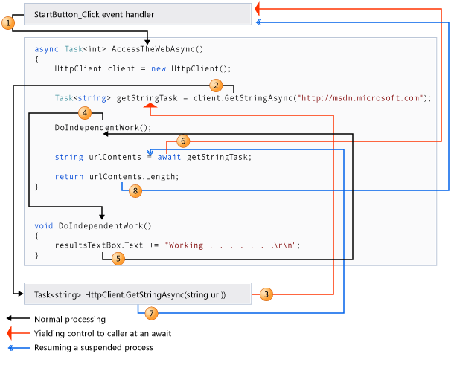
How it works?

Slide 6
Examples
Example 1 – The difference between synchronous and asynchronous
Example 2 – Real asynchronous and effective
Example 3 – Checking if everything has been done. Task.WhenAll(
Example 4 – Checking if anything has been done. .Any()

Slide 7
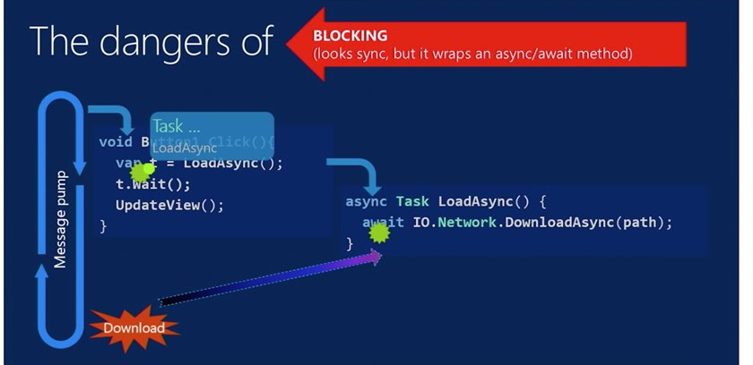
Async / Await – bad practises
Example 5
- DO NOT block asynchronous method by calling .Result or .Wait
- DO NOT use type void together with async (exceptions, state machine)
- DO NOT wrap synchronous code into asynchronous
Example 6

Slide 8


Async / Await – When and Where ???
From the bottom to the top
When? Do I really have an asyc. operation? Vs. Want to run in parallel
When? Performance can be higher or lower!
Where? Desktop apps -> UIThread
Where? Web apps -> go to the thread pool if idle and be used for sth. else
Async != faster. In fact, async is slower.
Utilize resources more efficiently
Depends on Backend

Slide 9
Async / Await Various Techniques
Example 10 - Task continuation
Example 11 - Task cancellation
Example 12 – Progress reporting

Slide 10
ConfigureAwait(false) - What's that ???
Defines "Synchronization context" -> contains Culture, HttpContext
Synchronization context ends at the end of a method
Default value: Standard .NET = true
.NET Core = true
ASP.NET Core = false (no synch. context!!!)
Despite ASP.NET Core always use Configure.Await - .NET Standard
For libraries use false, On app level use true if necesssary, otherwise false

Slide 11
Parallelism and thread synchronization
Single thread
Lock
Monitor
Multiple threads
Semaphore
Reader/Writer lock
Mutex
Example 20b - Real example
Example 21 - Deadlocks
Example 20a - Lock and atomic operations

Slide 12
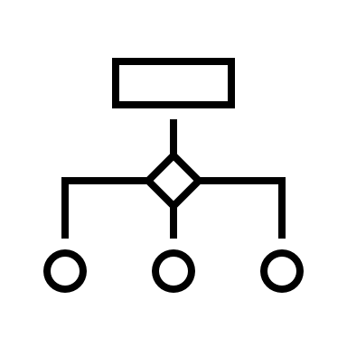
Parallel extensions and TPL
Parallel.Invoke
Executes an array of Action delegates in parallel, and then waits for them to complete
Parallel.For
Parallel equivalent of a C# for loop
Parallel.ForEach
Parallel equivalent of a C# foreach loop
Example 22 - Parallel.ForEach

Slide 13

Sources
Examples - source
https://github.com/tomasandrek/async-and-parallel-programming-presentation
Docker
https://www.docker.com/
.NET Core
https://dotnet.microsoft.com/download
Visual Studio Code
https://code.visualstudio.com/
Linux – Debian :-)
https://www.debian.org/

Slide 14
Thank you
Ing. Tomáš Andrek

